Slide 1
XSLT

Slide 2
Introduction to XSLT
XML Transformation
Used to transform one xml document to other xml
Version 1.0, 2.0, (3.0)

Slide 3
XSLT Transformation
XML Document
*
*
*
*
*
*
Processor
XSLT
Result Document
XSLT Code

Slide 4
Simple Transformation
<?xml version="1.0" encoding="UTF-8"?>
<company>
<resource>
<id>22</id>
<name>Govind Phate</name>
<designation>SE</designation>
</resource>
</company>
<?xml version="1.0" encoding="UTF-8"?>
<xsl:stylesheet version="1.0" xmlns:xsl="http://www.w3.org/1999/XSL/Transform">
<xsl:output method="xml" version="1.0" encoding="UTF-8" indent="yes"/>
<xsl:template match="/">
<employees>
<employee>
<xsl:attribute name="id">
<xsl:value-of select="/company/resource/id"/>
</xsl:attribute>
<xsl:element name="name">
<xsl:value-of select="/company/resource/name"/>
</xsl:element>
<xsl:element name="des">
<xsl:value-of select="/company/resource/designation"/>
</xsl:element>
</employee>
</employees>
</xsl:template>
</xsl:stylesheet>
<employee id="{/company/resource/id}">
<name>
<xsl:value-of select="/company/resource/name"/>
</name>
<des>
<xsl:value-of select="/company/resource/designation"/>
</des>
</employee>
+
<?xml version="1.0" encoding="UTF-8"?>
<employees>
<employee id="22">
<name>Govind Phate</name>
<des>SE</des>
</employee>
</employees>

Slide 5
For Loop
<?xml version="1.0" encoding="UTF-8"?>
<company>
<resource>
<id>22</id>
<name>Govind Phate</name>
<designation>SE</designation>
</resource>
<resource>
<id>23</id>
<name>Gyanesh Phutani</name>
<designation>Arch</designation>
</resource>
</company>
<?xml version="1.0" encoding="UTF-8"?>
<xsl:stylesheet version="1.0" xmlns:xsl="http://www.w3.org/1999/XSL/Transform">
<xsl:output method="xml" version="1.0" encoding="UTF-8" indent="yes"/>
<xsl:template match="/">
<employees>
<xsl:for-each select="/company/resource">
<employee id="{id}">
<name>
<xsl:value-of select="name"/>
</name>
<des>
<xsl:value-of select="designation"/>
</des>
</employee>
</xsl:for-each>
</employees>
</xsl:template>
</xsl:stylesheet>
<?xml version="1.0" encoding="UTF-8"?>
<employees>
<employee id="22">
<name>Govind Phate</name>
<des>SE</des>
</employee>
<employee id="23">
<name>Gyanesh Phutani</name>
<des>Arch</des>
</employee>
</employees>

Slide 6
Sorting
<?xml version="1.0" encoding="UTF-8"?>
<company>
<resource>
<id>22</id>
<name>Govind Phate</name>
<designation>SE</designation>
</resource>
<resource>
<id>23</id>
<name>Gyanesh Phutani</name>
<designation>Arch</designation>
</resource>
</company>
<?xml version="1.0" encoding="UTF-8"?>
<xsl:stylesheet version="1.0" xmlns:xsl="http://www.w3.org/1999/XSL/Transform">
<xsl:output method="xml" version="1.0" encoding="UTF-8" indent="yes"/>
<xsl:template match="/">
<employees>
<xsl:for-each select="/company/resource">
<xsl:sort select="designation“/>
<employee id="{id}">
<name>
<xsl:value-of select="name"/>
</name>
<des>
<xsl:value-of select="designation"/>
</des>
</employee>
</xsl:for-each>
</employees>
</xsl:template>
</xsl:stylesheet>
<?xml version="1.0" encoding="UTF-8"?>
<employees>
<employee id="23">
<name>Gyanesh Phutani</name>
<des>Arch</des>
</employee>
<employee id="22">
<name>Govind Phate</name>
<des>SE</des>
</employee>
</employees>

Slide 7
Copy-of
<?xml version="1.0" encoding="UTF-8"?>
<company>
<resource>
<id>22</id>
<name>Govind Phate</name>
<designation>SE</designation>
</resource>
<resource>
<id>23</id>
<name>Gyanesh Phutani</name>
<designation>Arch</designation>
</resource>
</company>
<?xml version="1.0" encoding="UTF-8"?>
<xsl:stylesheet version="1.0" xmlns:xsl="http://www.w3.org/1999/XSL/Transform">
<xsl:output method="xml" version="1.0" encoding="UTF-8" indent="yes"/>
<xsl:template match="/">
<employees>
<xsl:for-each select="/company/resource">
<xsl:sort select="designation“/>
<xsl:copy-of select=“.“/>
</xsl:for-each>
</employees>
</xsl:template>
</xsl:stylesheet>
<?xml version="1.0" encoding="UTF-8"?>
<employees>
<resource>
<id>23</id>
<name>Gyanesh Phutani</name>
<designation>Arch</designation>
</resource>
<resource>
<id>22</id>
<name>Govind Phate</name>
<designation>SE</designation>
</resource>
</employees>

Slide 8
Apply Template - Template Match
<?xml version="1.0" encoding="UTF-8"?>
<company>
<resource>
<id>22</id>
<name>Govind Phate</name>
<designation>SE</designation>
</resource>
<resource>
<id>23</id>
<name>Gyanesh Phutani</name>
<designation>Arch</designation>
</resource>
</company>
<?xml version="1.0" encoding="UTF-8"?>
<xsl:stylesheet version="1.0" xmlns:xsl="http://www.w3.org/1999/XSL/Transform">
<xsl:output method="xml" version="1.0" encoding="UTF-8" indent="yes"/>
<xsl:template match="/">
<employees>
<xsl:apply-templates select="/company/resource"/>
</employees>
</xsl:template>
<xsl:template match="resource">
<employee id="{id}">
<name>
<xsl:value-of select="name"/>
</name>
<des>
<xsl:value-of select="designation"/>
</des>
</employee>
</xsl:template>
</xsl:stylesheet>
<?xml version="1.0" encoding="UTF-8"?>
<employees>
<employee id="22">
<name>Govind Phate</name>
<des>SE</des>
</employee>
<employee id="23">
<name>Gyanesh Phutani</name>
<des>Arch</des>
</employee>
</employees>

Slide 9
If
<?xml version="1.0" encoding="UTF-8"?>
<xsl:stylesheet version="2.0" xmlns:xsl="http://www.w3.org/1999/XSL/Transform">
<xsl:output method="xml" version="1.0" encoding="UTF-8" indent="yes"/>
<xsl:template match="/">
…
</xsl:template>
<xsl:template match="resource">
<employee id="{id}">
<name>
<xsl:attribute name="first">
<xsl:value-of select="tokenize(name,' ')[1]"/>
</xsl:attribute>
<xsl:if test="contains(name,' ')">
<xsl:attribute name="last">
<xsl:value-of select="tokenize(name,' ')[2]"/>
</xsl:attribute>
</xsl:if>
</name>
<des><xsl:value-of select="designation"/></des>
</employee>
</xsl:template>
</xsl:stylesheet>
<?xml version="1.0" encoding="UTF-8"?>
<company>
<resource>
<id>22</id>
<name>Govind Phate</name>
<designation>SE</designation>
</resource>
<resource>
<id>23</id>
<name>Gyanesh Phutani</name>
<designation>Arch</designation>
</resource>
<resource>
<id>21</id>
<name>Gulal</name>
<designation>SE</designation>
</resource>
</company>
<?xml version="1.0" encoding="UTF-8"?>
<employees>
<employee id="22">
<name first="Govind" last="Phate"/>
<des>SE</des>
</employee>
<employee id="23">
<name first="Gyanesh" last="Phutani"/>
<des>Arch</des>
</employee>
<employee id="21">
<name first="Gulal"/>
<des>SE</des>
</employee>
</employees>

Slide 10
Choice
<?xml version="1.0" encoding="UTF-8"?>
<company>
<resource>
<id>22</id>
<name>Govind Phate</name>
<designation>SE</designation>
</resource>
<resource>
<id>23</id>
<name>Gyanesh Phutani</name>
<designation>Arch</designation>
</resource>
<resource>
<id>21</id>
<name>Gulal</name>
<designation>SE</designation>
</resource>
</company>
<xsl:template match="resource">
<employee id="{id}">
<xsl:choose>
<xsl:when test="contains(name,' ')">
<name first="{tokenize(name,' ')[1]}" last="{tokenize(name,' ')[2]}"/>
</xsl:when>
<xsl:otherwise>
<name first="{name}"/>
</xsl:otherwise>
</xsl:choose>
<des><xsl:value-of select="designation"/></des>
</employee>
</xsl:template>
<?xml version="1.0" encoding="UTF-8"?>
<employees>
<employee id="22">
<name first="Govind" last="Phate"/>
<des>SE</des>
</employee>
<employee id="23">
<name first="Gyanesh" last="Phutani"/>
<des>Arch</des>
</employee>
<employee id="21">
<name first="Gulal"/>
<des>SE</des>
</employee>
</employees>

Slide 11
With Namespaces
<?xml version="1.0" encoding="UTF-8"?>
<xsl:stylesheet version="1.0"
xmlns:xsl="http://www.w3.org/1999/XSL/Transform"
xmlns:i="http://tibco.com/training/xslt/input"
xmlns:o="http://tibco.com/training/xslt/output">
<xsl:output method="xml" version="1.0" encoding="UTF-8" indent="yes"/>
<xsl:template match="/">
<o:employees>
<xsl:for-each select="/i:company/i:resource">
<o:employee>
<xsl:attribute name="id">
<xsl:value-of select="i:id"/>
</xsl:attribute>
<o:name>
<xsl:value-of select="i:name"/>
</o:name>
<o:des>
<xsl:value-of select="i:designation"/>
</o:des>
</o:employee>
</xsl:for-each>
</o:employees>
</xsl:template>
</xsl:stylesheet>
<?xml version="1.0" encoding="UTF-8"?>
<company
xmlns="http://tibco.com/training/xslt/input">
<resource>
<id>22</id>
<name>Govind Phate</name>
<designation>SE</designation>
</resource>
</company>
<?xml version="1.0" encoding="UTF-8"?>
<o:employees
xmlns:i="http://tibco.com/training/xslt/input"
xmlns:o="http://tibco.com/training/xslt/output">
<o:employee id="22">
<o:name>Govind Phate</o:name>
<o:des>SE</o:des>
</o:employee>
</o:employees>

Slide 12
Exclude-result-prefix
<?xml version="1.0" encoding="UTF-8"?>
<xsl:stylesheet version="1.0"
xmlns:xsl="http://www.w3.org/1999/XSL/Transform"
xmlns:i="http://tibco.com/training/xslt/input"
xmlns:o="http://tibco.com/training/xslt/output"
exclude-result-prefixes=“i">
<xsl:output method="xml" version="1.0" encoding="UTF-8" indent="yes"/>
<xsl:template match="/">
<o:employees>
<xsl:for-each select="/i:company/i:resource">
<o:employee>
<xsl:attribute name="id">
<xsl:value-of select="i:id"/>
</xsl:attribute>
<o:name>
<xsl:value-of select="i:name"/>
</o:name>
<o:des>
<xsl:value-of select="i:designation"/>
</o:des>
</o:employee>
</xsl:for-each>
</o:employees>
</xsl:template>
</xsl:stylesheet>
<?xml version="1.0" encoding="UTF-8"?>
<company
xmlns="http://tibco.com/training/xslt/input">
<resource>
<id>22</id>
<name>Govind Phate</name>
<designation>SE</designation>
</resource>
</company>
<?xml version="1.0" encoding="UTF-8"?>
<o:employees
xmlns:o="http://tibco.com/training/xslt/output">
<o:employee id="22">
<o:name>Govind Phate</o:name>
<o:des>SE</o:des>
</o:employee>
</o:employees>

Slide 13
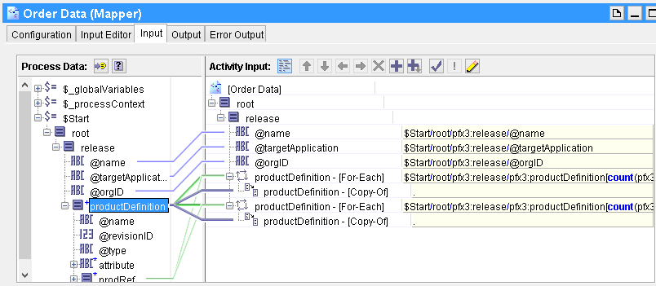
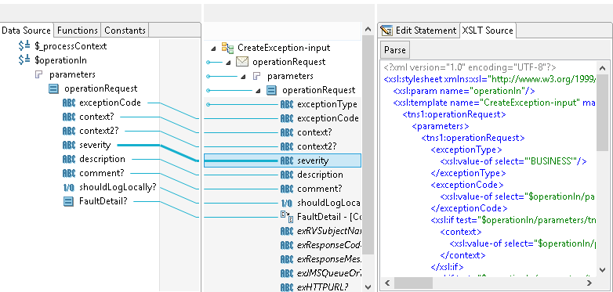
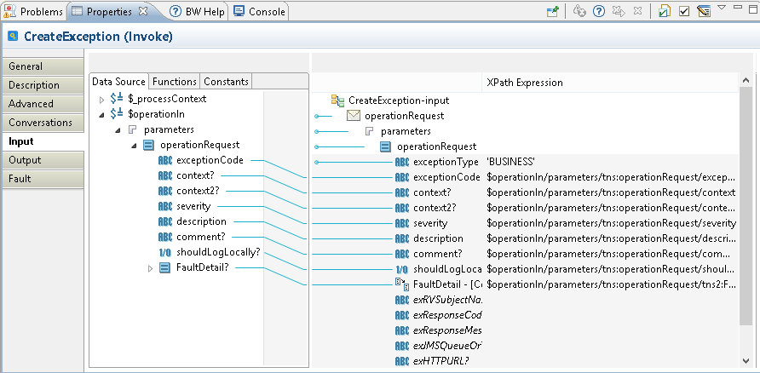
Mapper

Slide 14

Queries

Slide 15

Exercise
Online XSLT Transformation Tool http://www.w3schools.com/xsl/tryxslt.asp?xmlfile=cdcatalog&xsltfile=cdcatalog

